Slide 1
NETWORK BASICS

Slide 2

STANDALONE ALONE COMPUTER
Standalone Computer
Limited Functionalities
Input
Processing
Output

Slide 3


CONNECTED COMPUTERS
Two machines connected
Medium- wire/wireless/optical Fibre
Comn interface- Send/Receive
Rules for Communication

Slide 4
TYPES OF TRANSMISSION
Simplex
Machine A Tx
Machine B Rx
A
B
Half Duplex
If Machine A Tx Machine B Rx
If Machine B Tx Machine A Rx
A
B
Duplex
Machine A and B can Tx & Rx simultaneously

Slide 5
TRANSMISSION MEDIA
Important Characteristics
EMI/Modal dispersion
Frequency
Bandwidth
Data Rate
Wire
Copper- Coaxial, TP, UTP
Optics
Optical Fibre Cable- Single mode or Multimode cable
Wireless
IR
Microwave
Cellular
Radio
Wired media- medium characteristic
Wireless media- Signal characteristic

Slide 6
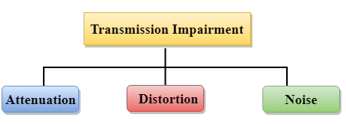
TRANSMISSION MEDIA: IMPAIRMENT
Attenuation. loss of energy, i.e., the strength of the signal decreases with increasing the distance which causes the loss of energy.
Distortion. Distortion occurs when there is a change in the shape of the signal.
Noise. When data is travelled over a transmission medium, some unwanted signal is added to it which creates the noise.

Slide 7
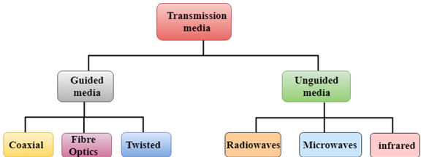
TRANSMISSION MEDIA: CLASSIFICATION
Guided Media
Physical medium through which the signals are transmitted also called as Bounded media.
UnGuided Transmission
Transmits EM waves without using any physical medium.
It is also known as wireless transmission.
In unguided media, air is the media.

Slide 8
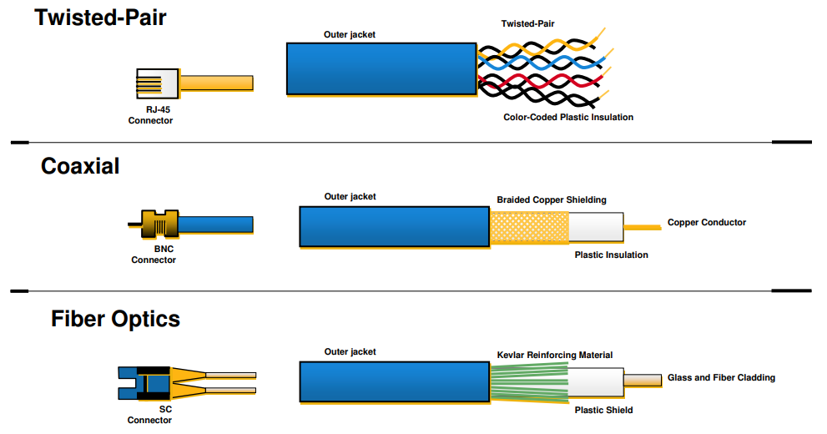
Physical Media Types

Slide 9
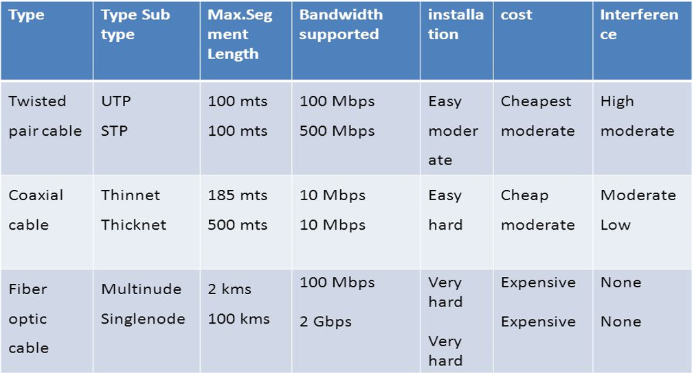
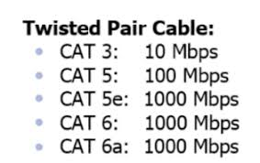
Physical Media Comparison

Slide 10
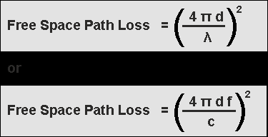
PATH LOSS AND FREQUENCY

Slide 11
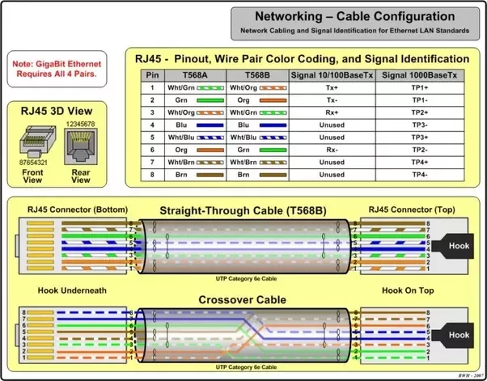
CABLE CONFIGURATION

Slide 12
UTP CABLE WIRE UTILITY
There are 8 total wires inside a modern Ethernet twisted-pair cable braided into 4 pairs.
All of the 8 wires can be put to work for 1000Base-T/GigE signalling at rates up to 1 Gbps, but only 4 are needed for either 10Base-T signalling at rates up to 10 Mbps or 100Base-T/Fast-E signalling at rates up to 100 Mbps.
signal100Base-T or lower frees up wires for other uses.
In the 802.11af Power over Ethernet standard, wires 4 and 5 are ground wires, and wires 7 and 8 are live power wires.

Slide 13
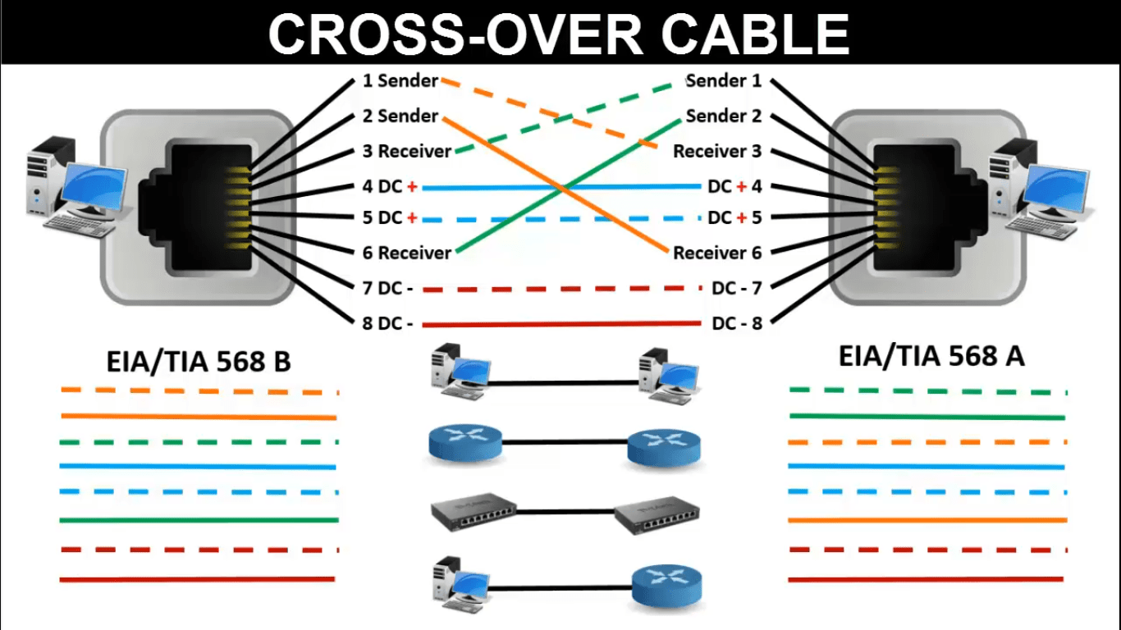
CABLE CONNECTION: STRAIGHT & CROSS

Slide 14
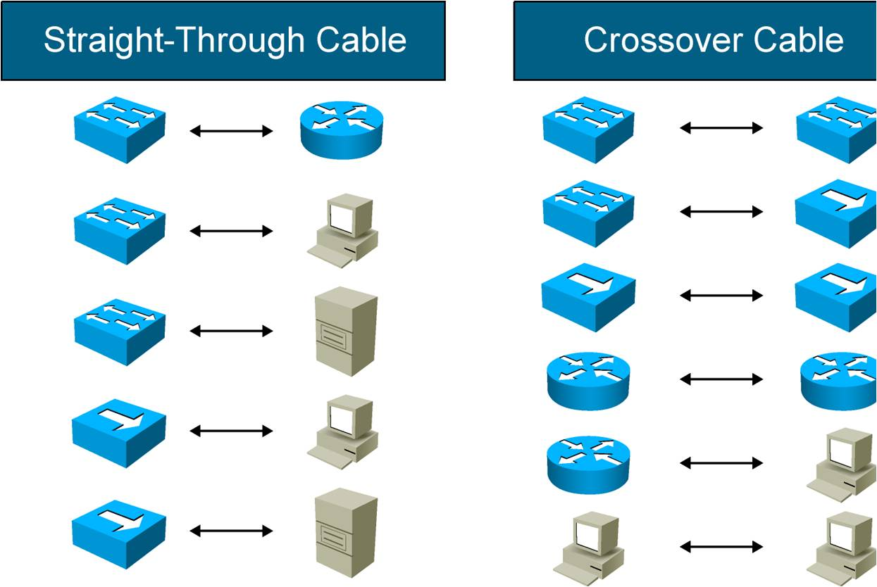
CABLE CONNECTION

Slide 15
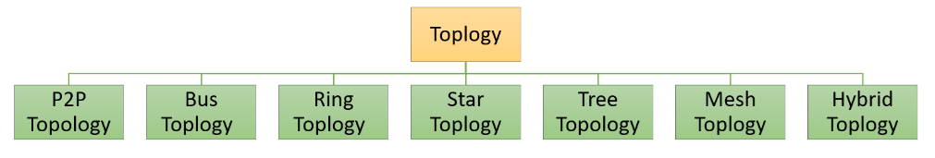

Slide 16
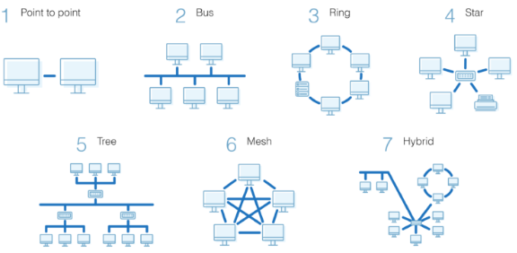
NETWORK TOPOLOGY

Slide 17
NODE COMMUNICATION
Point-to-Point
Directed LOS
Bus
Terminator
Taps

Slide 18
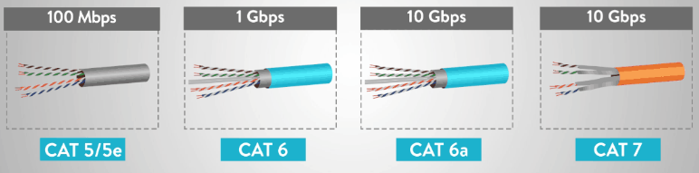
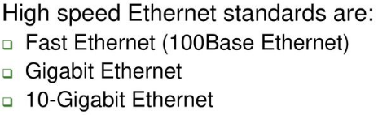
LAN TECHNOLOGIES
Ethernet is a communication standard that was developed in the early ’80s to network computers and other devices in a local environment such as a home or a building.
This local environment is defined as a LAN and it connects multiple devices so that they can create, store and share information with others in the location.
Ethernet is a wired system that started with using coaxial cable and has successfully progressed to now using twisted pair copper wiring and fibre optic wiring.
In 1983, Ethernet was standardized into the standard IEEE 802.3 by the Institute of Electrical and Electronic Engineers (IEEE).
This standard defined the physical layer and the MAC (media access control) portion of the “data link” layer of wired Ethernet.
These two layers are defined as the first two layers in the OSI (Open Systems Interconnection) model. The physical layer consists of the following components:-
Cabling
Devices
Ethernet Protocol
Most popular protocol.
Access method- CSMA/CD
Topologies- Bus, Star or Tree
UTP/Coaxial/OFC
Ethernet can handle about 10,000,000 bits per second and can be used with almost any kind of computer.
LAN standards have raised the Ethernet speed limit from 10 megabits per second (Mbps) to 100Mbps for Fast Ethernet and 1000Mbps for Gigabit Ethernet with only minimal changes made to the existing cable structure.
LAN Technologies
Ethernet
Local Talk
Token Ring
FDDI

Slide 19
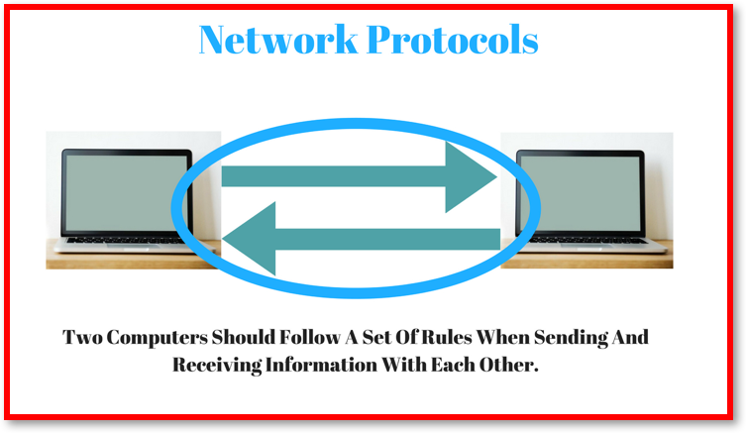
ETHERNET POTOCOL
Ethernet Protocols
The Ethernet refers to a family of related networking rules or protocols widely used in Local Area Networks (LAN).
This is set of rules that governs how data frames are formatted ready for transmission between computers on the same network.
This is similar to polite human conversation, nodes wait until the connection is quiet before attempting to 'Speak' or transmit.
Two nodes attempting to transmit simultaneously will stop and each will wait a random period of time before re-attempting transmission.
Each Ethernet device has a unique 48-bit MAC address and these addresses specify the source and destination of each frame. These are usually displayed as a 12-digit hexadecimal number.
All new computers have Ethernet interfaces built-in to motherboards, and older machines can be fitted with NIC cards.
The standard network cable used with Ethernet are often referred to as Ethernet cable.

Slide 20
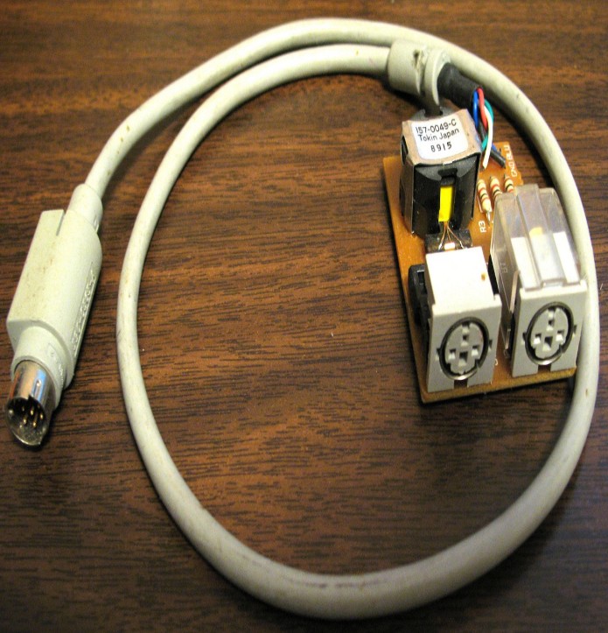
LOCALTALK
LocalTalk is a network protocol developed by Apple Computer, Inc. for Macintosh computer machines.
The method used by LocalTalk is CSMA / CA (Carrier Sense Multiple Access with Collision Avoidance).
LocalTalk adapters and special twisted pair cable can be used to connect multiple computers through the serial port.
Macintosh Operating System allows peer-to-peer network connection without the need for additional special applications.
The LocalTalk protocol can be used for Straight Line, Star, or Tree models using a twisted pair cable. Lack of the most striking is the speed of the transmissions. The transmission speed is only 230 Kbps.

Slide 21
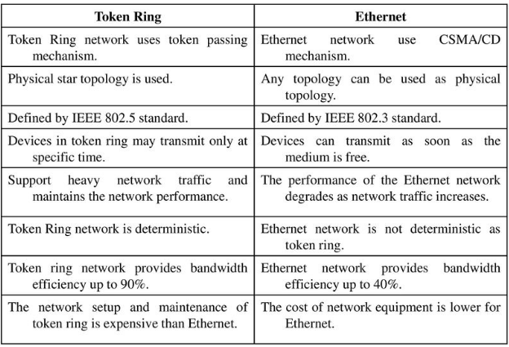
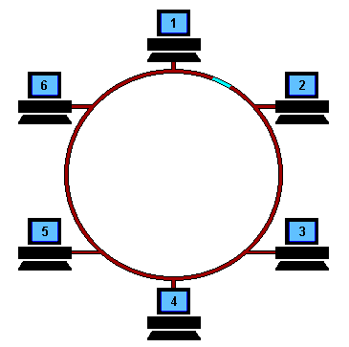
TOKEN RING TECHNOLOGY
Token Ring is a computer networking technology used to build local area networks.
It uses a special three-byte frame called a token that travels around a logical ring of workstations or servers.
This token passing is a channel access method providing fair access for all stations, and eliminating the collisions of contention-based access methods.
Token Ring was introduced by IBM in 1984, and standardized in 1989 as IEEE 802.5.
It was a successful technology, particularly in corporate environments, but was gradually eclipsed by the later versions of Ethernet(Fast & Gigabit Ethernet).
To use the network, a machine first has to capture the free Token and replace the data with its own message.
In the example on right , machine 1 wants to send some data to machine 4, so it first has to capture the free Token. It then writes its data and the recipient's address onto the Token.
The packet of data is then sent to machine 2 who reads the address, realizes it is not its own, so passes it on to machine 3.
Machine 3 does the same and passes the Token on to machine 4. This time it is the correct address and so number 4 reads the message. It cannot, however, release a free Token on to the ring, it must first send the frame back to number 1 with an acknowledgement to say that it has received the data.
The receipt is then sent to machine 5 who checks the address, realizes that it is not its own and so forwards it on to the next machine in the ring, number 6.
Machine 6 does the same and forwards the data to number 1, who sent the original message. Machine 1 recognizes the address, reads the acknowledgement from number 4 and then releases the free Token back on to the ring ready for the next machine to use.

Slide 22
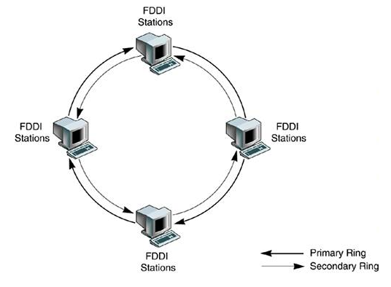
FDDI TECHNOLOGY
FDDI is a dual-ring topology networking architecture based on a token-passing access method.
Secondary Ring is one of the two rings used in Fiber Distributed Data Interface (FDDI) networks to interconnect stations on the network.
The secondary ring usually sits dark (unused), except when a fault occurs on the primary ring, in which case the network reconfigures itself to make use of the secondary ring to wrap around the fault.
Because the data travels on the secondary ring in the opposite direction that it was traveling on the primary ring, when it’s put to use, the secondary ring reroutes data back the way it came, thus avoiding the problem spot.
The dual-ring configuration provides FDDI with a degree of fault tolerance – if a computer or cable on the primary ring goes down, the secondary ring is put to use, working in conjunction with the portion of the primary ring that isn’t broken.

Slide 23
CSMA CA vs CSMA CD
Carrier Sense Multiple Access or CSMA is a Media Access Control (MAC) protocol.
Controls the flow of data in a transmission media so that packets do not get lost and data integrity is maintained.
CSMACD- Wired media
CSMACA- Wireless medium
CSMA CA does not deal with the recovery after a collision.
What it does is to check whether the medium is in use. If it is busy, then the transmitter waits until it is idle before it starts transmitting.
This effectively minimizes the possibility of collisions and makes more efficient use of the medium.
CSMA CD operates by detecting the occurrence of a collision.
Once a collision is detected, CSMA CD immediately terminates the transmission so that the transmitter does not have to waste a lot of time in continuing.
The last information can be retransmitted.
CSMA CD takes effect after a collision while CSMA CA takes effect before a collision. CSMA CA reduces the possibility of a collision while CSMA CD only minimizes the recovery time. CSMA CD is typically used in wired networks while CSMA CA is used in wireless networks.

Slide 24
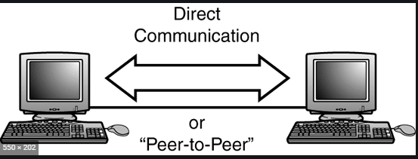
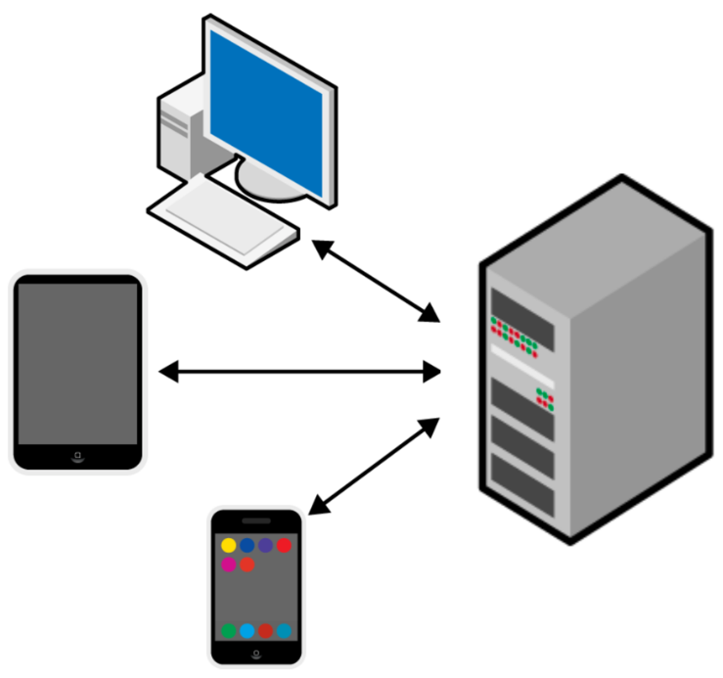
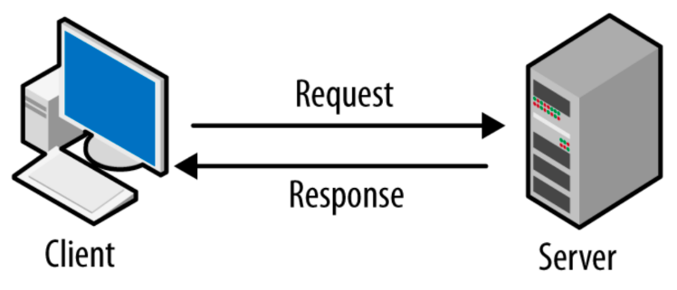
LAN TYPES
Peer-to-Peer Networks | Client/Server Networks
Each PC is an equal participant on the network | One PC acts as the network controller
PCs are not reliant on one PC for resources such as the printer | One PC controls access to network resources
Access to the network is not centrally controlled | Network access and security are centrally controlled
Can operate on a basic PC operating system | Need a special operating system
Are generally simpler and lower cost | Are generally more complex but give the user more control
Peer-to-peer
Peer-to-peer access control allows users to share resources and files located on their computers and to access shared found on other computers.
Eg- OS like AppleShare, Windows for Workgroups.
Client/Server
Client/server network operating systems allow the network to centralise functions and applications in one or more dedicated file servers.
Allows multiple users to simultaneously share resources irrespective of physical location.
Eg- Windows NT Server

Slide 25
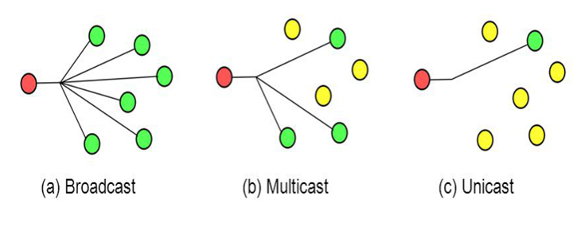
LAN DATA TRANSMISSION METHODS
Classification
Unicast
Multicast
Broadcast
Unicast Transmission- a single packet is sent from the source to a destination on a network.
First, the source node addresses the packet by using the address of the destination node.
The package is then sent onto the network and finally network passes the packet to its destination.
Multicast Transmission- consists of a single data packet that is copied and sent to a specific subset of nodes on the network.
First the source node addresses the packet by using a multicast address
The packet is then sent then into the network, which makes copies of the packet and sends a copy to each node that is part of the muticast address.
A broadcast transmission consists of a single data packet that is copied and sent to all nodes on the network.
In these types of transmission, the source node addresses the packet by using the broadcast address.
The packet is then sent on to the network, which makes copies of the packet and sends a copy to every node on the network.

